Slide 1
GENERAL PHYSICS 2

Slide 2
OPENING PRAYER

Slide 3
ONLINE CLASS REMINDERS

Slide 4
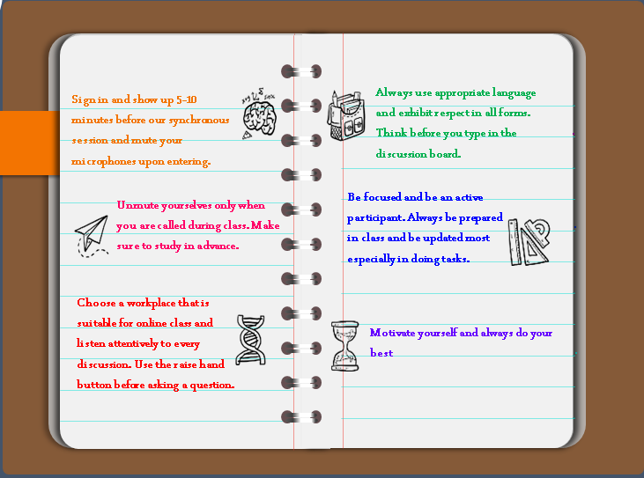

Slide 5
ELECTRICITY AND MAGNETISM
An Overview

Slide 6
LEARNING OBJECTIVES

Slide 7
LEARNING OBJECTIVES
Differentiate electricity from electric current
Enumerate the components of a simple circuit
Differentiate series and parallel connection
Identify the different electrical symbols.

Slide 8
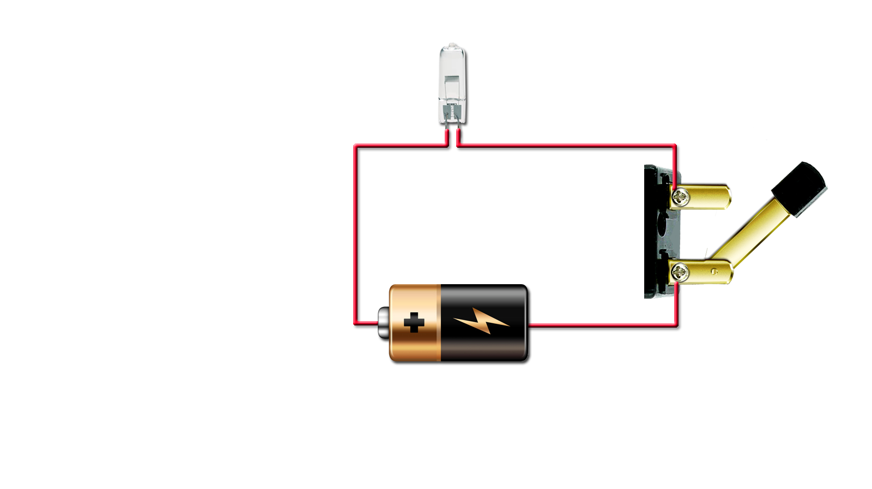
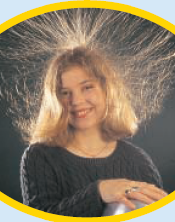
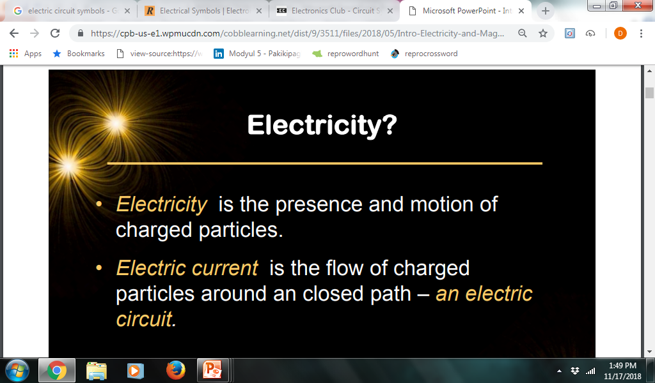
WHAT IS ELECTRICITY?

Slide 9
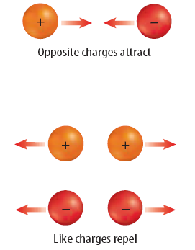
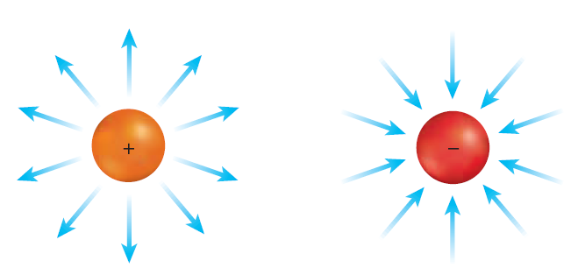
WHAT IS ELECTRICITY?
definition
definition
2 Types of Charge: (Positive & Negative)
Like charges repel while unlike charges attract.
Surrounding every charge is an electric field
.

Slide 10
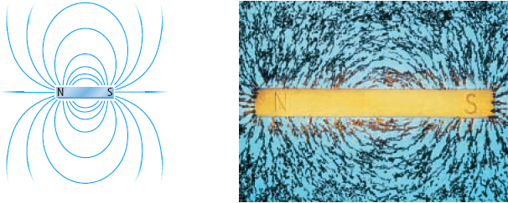
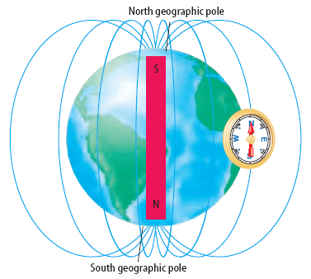
WHAT IS MAGNETISM?
definition
definition
It refers to the properties and interactions of magnets
Magnets produce magnetic forces and have magnetic field lines
.

Slide 11

COMMON
ELECTRICAL SYMBOLS
Teacher Guide
Click to display each component.
GLOBE
BATTERY
x1
BATTERIES
x2
BATTERIES
x3
WIRE
SWITCH
CLOSED
(ON)
SWITCH
OPEN
(OFF)
WIRES CROSSING
BUT NOT CONNECTED
Hide Teacher Guide
Show Teacher Guide

Slide 12


A SIMPLE
ELECTRICAL CIRCUIT
GLOBE
Teacher Guide
Click on the round white terminals of the switch or the black bar of the switch to light switch to turn the globe on and off.
WIRE
BATTERY
SWITCH
Hide Teacher Guide
Show Teacher Guide

Slide 13


SERIES & PARALLEL CIRCUITS
Teacher Guide
Click on the light switches to turn the globes on and off.
Note the relative brightness of globes.
Click on an illuminated globe to “break” it. Note the effect.
Click red arrow to reset (repair globes).
Click elsewhere to proceed to next slide.
⬅
Hide Teacher Guide
Show Teacher Guide

Slide 14

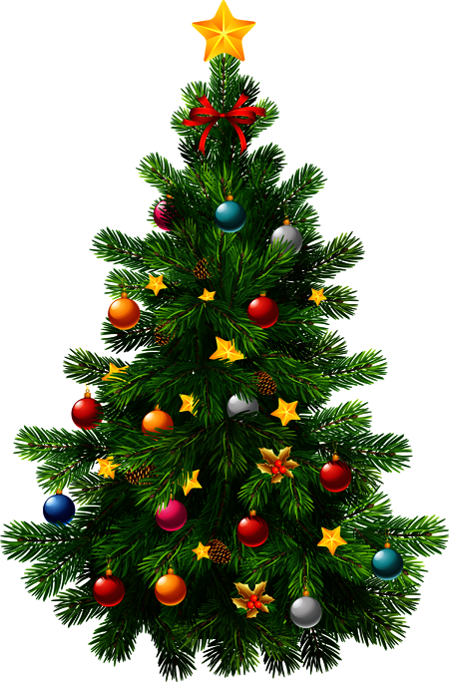
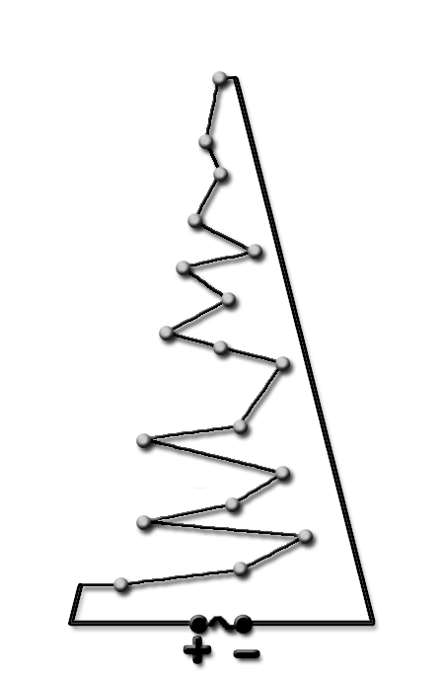





CHRISTMAS TREE LIGHTS SERIES
If one globe burns out, all lights will go out. The circuit is no longer closed.
Teacher Guide
Click on slide to “break” a globe.
Note all globes do not work.
Hide Teacher Guide
Show Teacher Guide

Slide 15
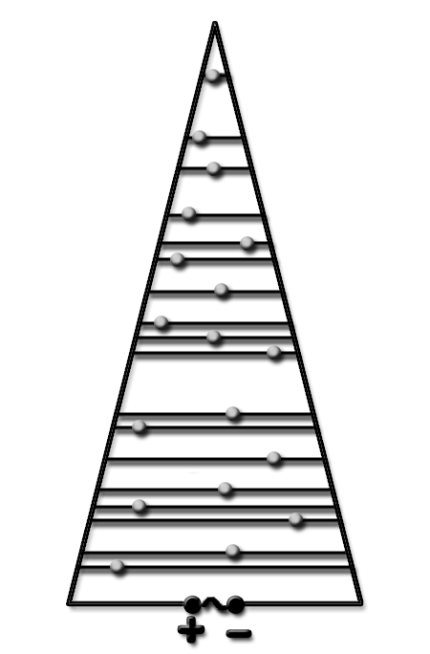
CHRISTMAS TREE LIGHTS PARALLEL
Teacher Guide
Repeatedly click on the slide to break globes.
Note all other globes remain working.
Repeat until all globes are off.
If one globe burns out, all other lights will remain on. The circuit is still closed.
Hide Teacher Guide
Show Teacher Guide

Slide 16
COMMON ELECTRICAL SYMBOLS
General Physics II

Slide 17
COMMON
ELECTRICAL SYMBOLS
definition
definition
Circuit symbols are used in circuit diagrams showing how a circuit is connected together.
The actual layout of the components is usually quite different from the circuit diagram.
GLOBE
BATTERY
x1
BATTERIES
x2
BATTERIES
x3
WIRE
SWITCH
CLOSED
(ON)
SWITCH
OPEN
(OFF)
WIRES CROSSING
BUT NOT CONNECTED

Slide 18
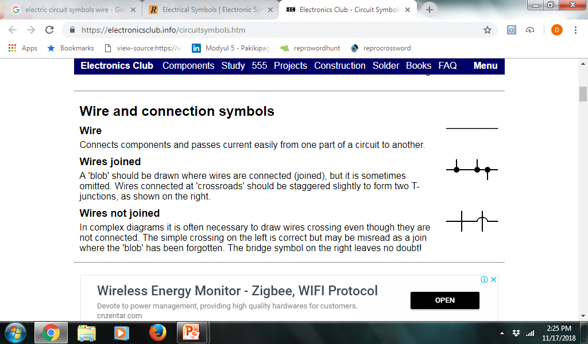
COMMON
ELECTRICAL SYMBOLS
WIRE
WIRES
WIRES JOINED / WIRES CONNECTED
WIRES NOT JOINED/ WIRES NOT CONNECTED

Slide 19
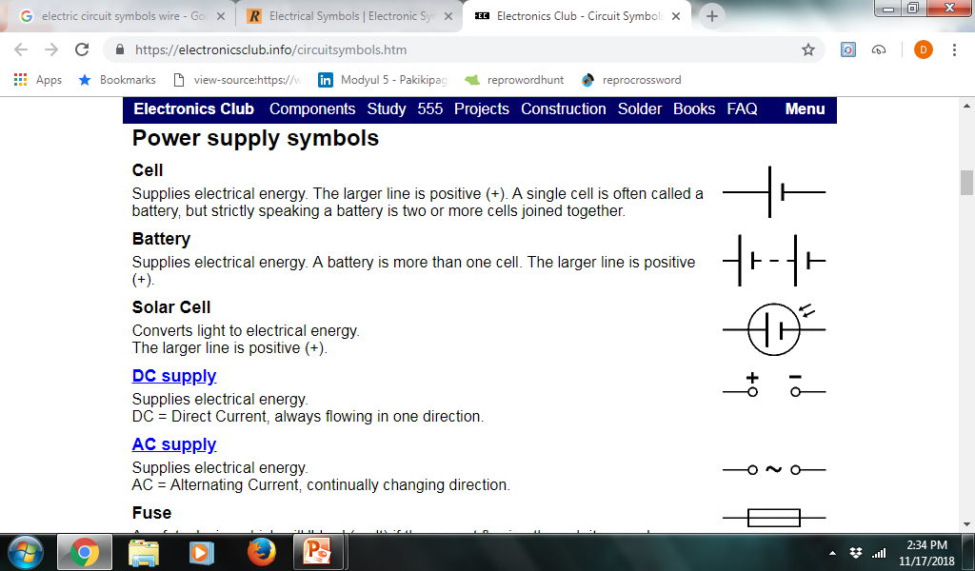
COMMON
ELECTRICAL SYMBOLS
CELL
POWER
SUPPLY
SYMBOLS
BATTERY
SOLAR CELL

Slide 20
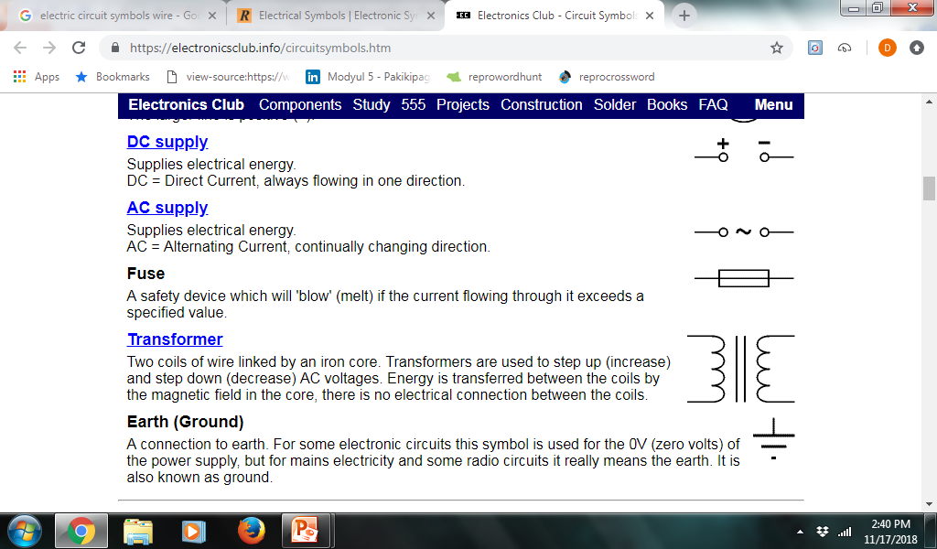
COMMON
ELECTRICAL SYMBOLS
DC SUPPLY
POWER
SUPPLY
SYMBOLS
AC SUPPLY
FUSE

Slide 21

COMMON
ELECTRICAL SYMBOLS
TRANSFORMER
POWER
SUPPLY
SYMBOLS
GROUND

Slide 22
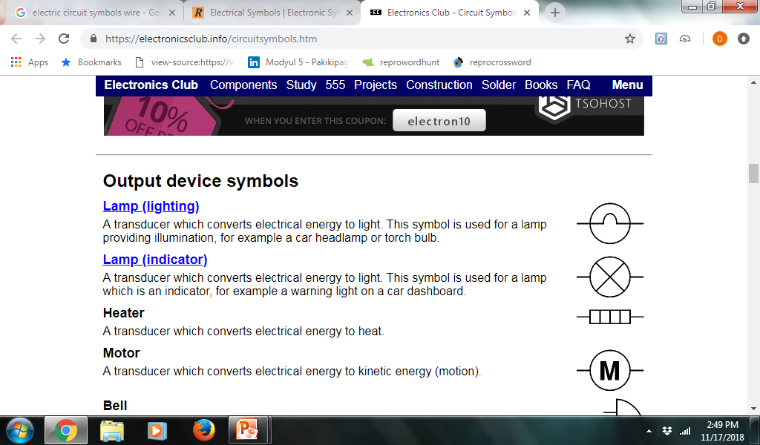
COMMON
ELECTRICAL SYMBOLS
LAMP (LIGHTING)
LAMP (INDICATOR)
OUTPUT
DEVICE
SYMBOLS
HEATER
MOTOR

Slide 23
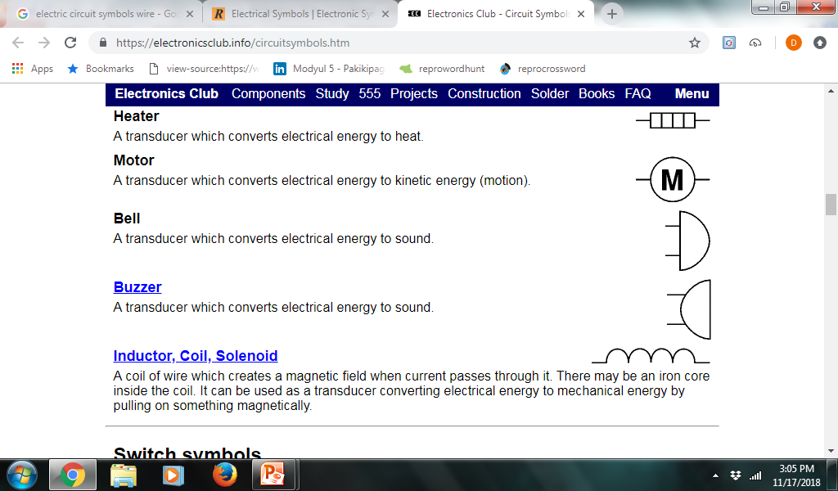
COMMON
ELECTRICAL SYMBOLS
BELL
OUTPUT
DEVICE
SYMBOLS
BUZZER
INDUCTOR, COIL, SOLENOID

Slide 24
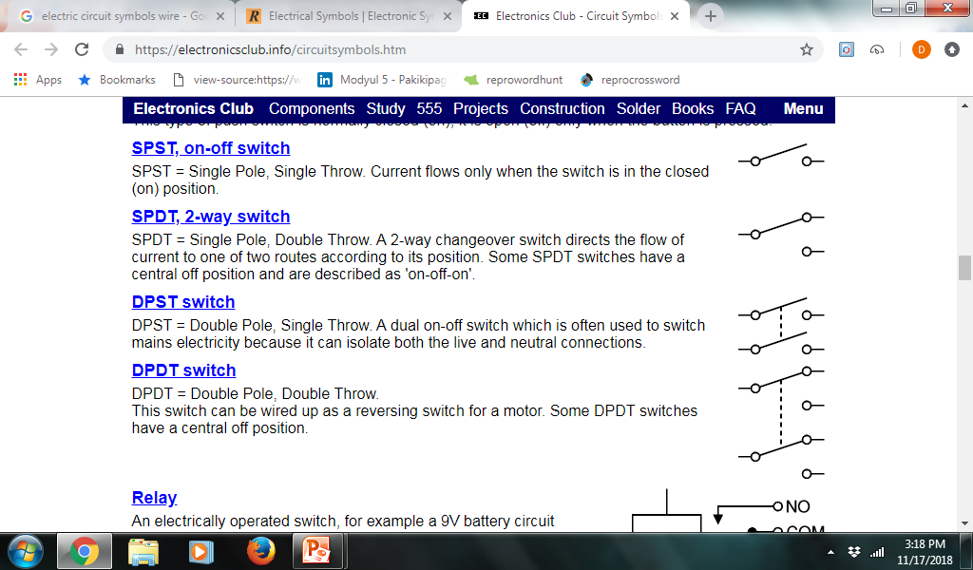
COMMON
ELECTRICAL SYMBOLS
SPST, on off switch
(SINGLE POLE, SINGLE THROW)
SWITCH
SYMBOLS
SPDT, 2 Way switch
(SINGLE POLE, DOUBLE THROW)

Slide 25

COMMON
ELECTRICAL SYMBOLS
DPST switch
(DOUBLE POLE, SINGLE THROW)
SWITCH
SYMBOLS
DPDT switch
(DOUBLE POLE, DOUBLE THROW)

Slide 26
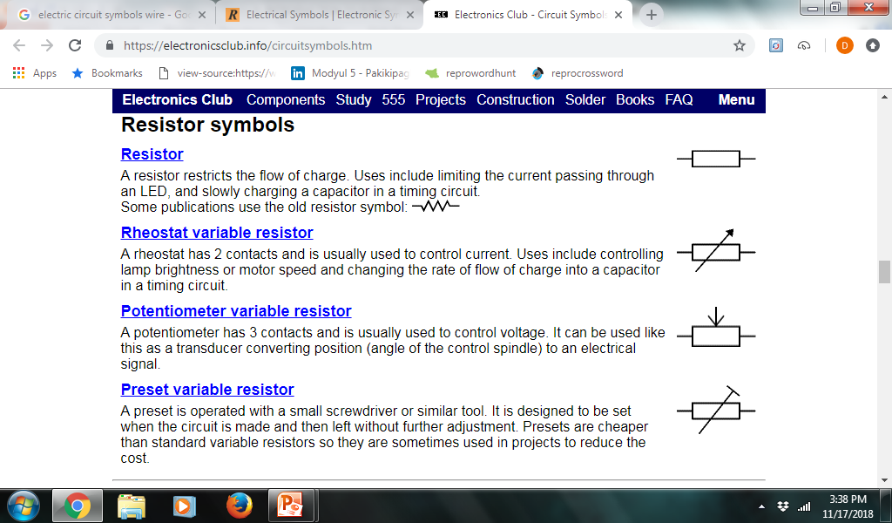
COMMON
ELECTRICAL SYMBOLS
RESISTOR
RHEOSTAT VARIABLE RESISTOR
RESISTOR
SYMBOLS
POTENTIOMETER VARIABLE RESISTOR
PRESET VARIABLE RESISTOR

Slide 27
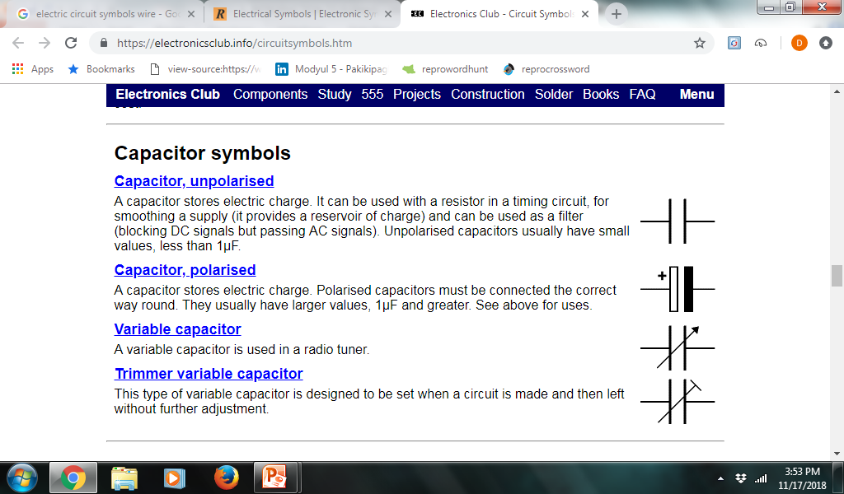
COMMON
ELECTRICAL SYMBOLS
CAPACITOR, unpolarised
CAPACITOR, polarised
CAPACITOR
SYMBOLS
VARIABLE CAPACITOR
TRIMMER VARIABLE CAPACITOR

Slide 28
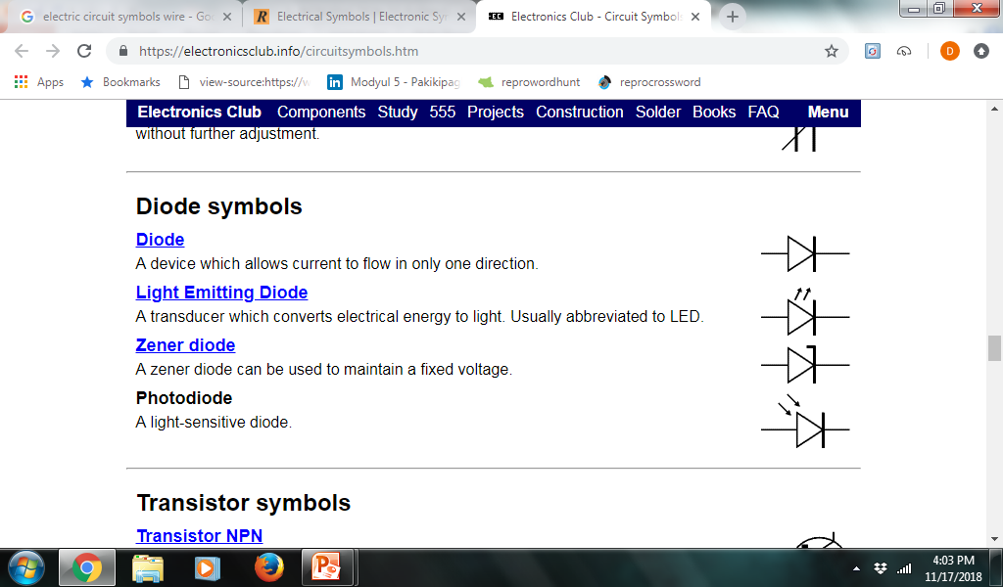
COMMON
ELECTRICAL SYMBOLS
DIODE
LIGHT EMITTING DIODE
DIODE
SYMBOLS
ZENER DIODE
PHOTODIODE

Slide 29
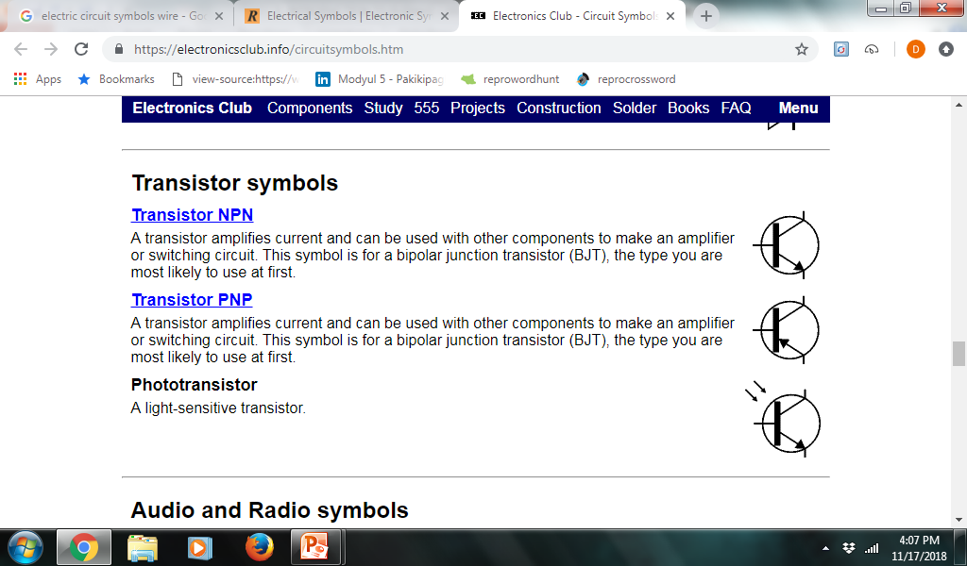
COMMON
ELECTRICAL SYMBOLS
TRANSISTOR NPN
TRANSISTOR
SYMBOLS
TRANSISTOR PNP
PHOTOTRANSISTOR

Slide 30
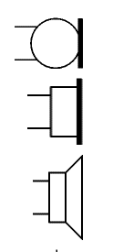
COMMON
ELECTRICAL SYMBOLS
MICROPHONE
AUDIO & RADIO
SYMBOLS
EARPHONE
LOUDSPEAKER

Slide 31
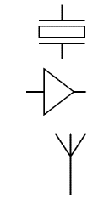
COMMON
ELECTRICAL SYMBOLS
PIEZO TRANSDUCER
AUDIO AND RADIO
SYMBOLS
AMPLIFIER
AERIAL (ANTENNA)

Slide 32
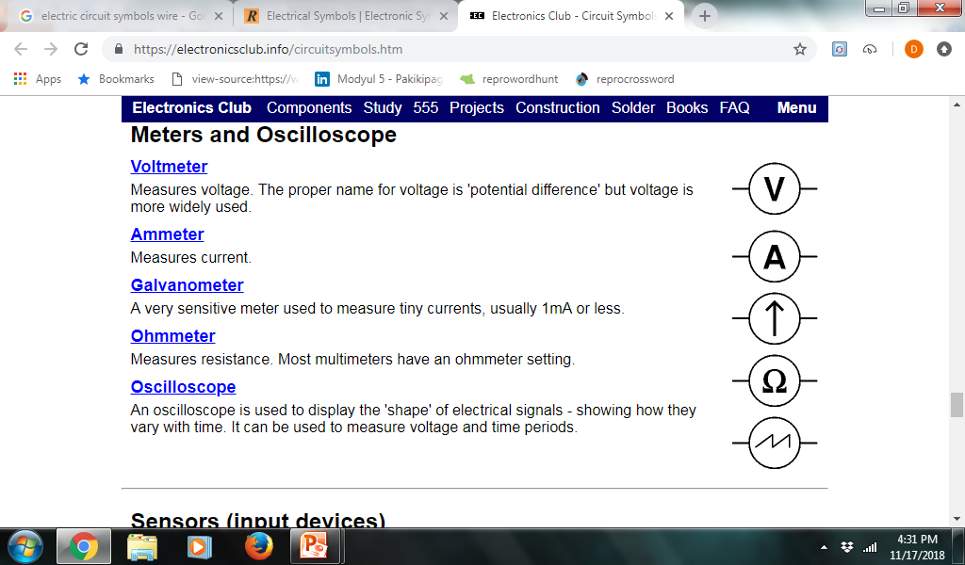
COMMON
ELECTRICAL SYMBOLS
VOLTMETER
AMMETER
METERS
SYMBOLS
GALVANOMETER
OHMMETER
OSCILLOSCOPE

Slide 33
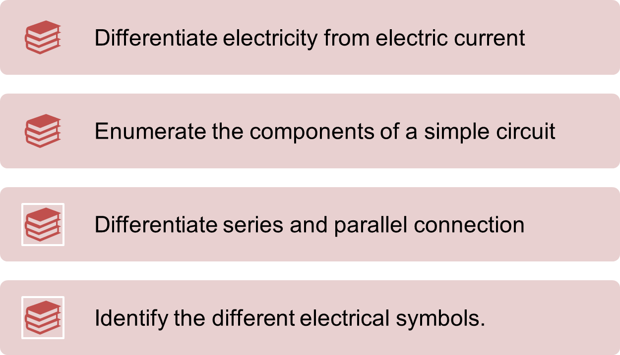
GENERALIZATION

Slide 34
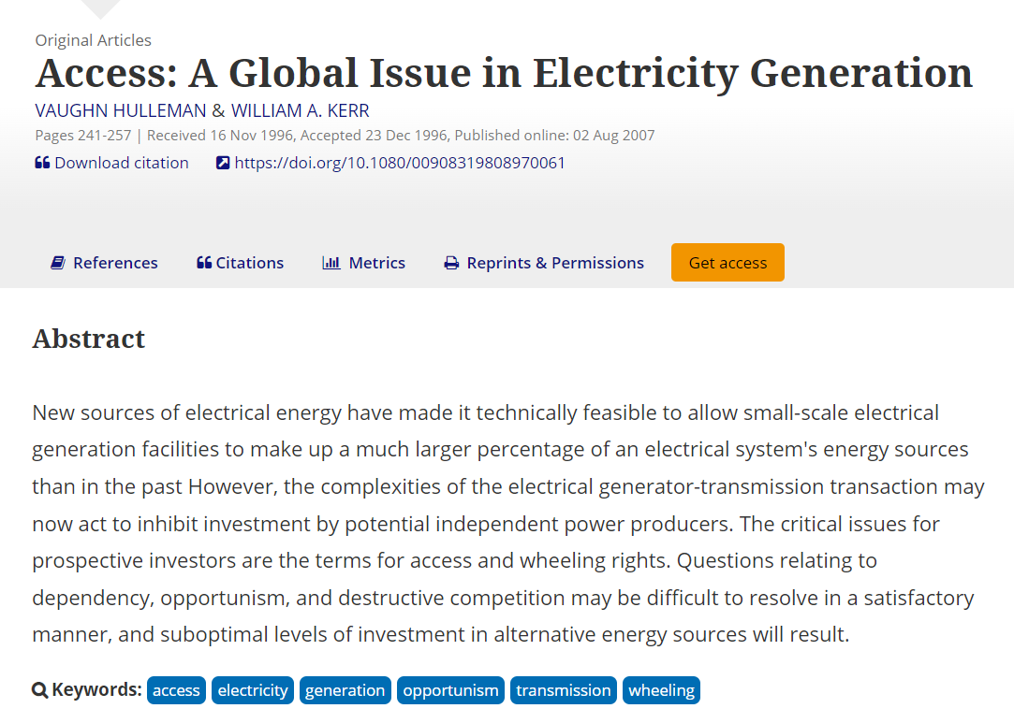

GLOBAL ISSUE

Slide 35
PERPETUALITE CORE VALUES
Love of Self, Family, and Neighbors
Regularly check electrical wirings

